Slide 1

Team (5)
Thomas lee (154433k) ,shaun (151719k)
wafiy yazid (152978g) ,clynton (154548k)

Slide 2
Content
Objective and Scope
Smart Home System Database
Project Sensors
System Highlights
Project Task Allocation

Slide 3
1. Objective and Scope
Create a one-fit-all Smart Home system
User friendly installation
Cost efficient with replaceable sensors
Bringing Singapore one step closer to achieving full “Smart Nation”

Slide 4
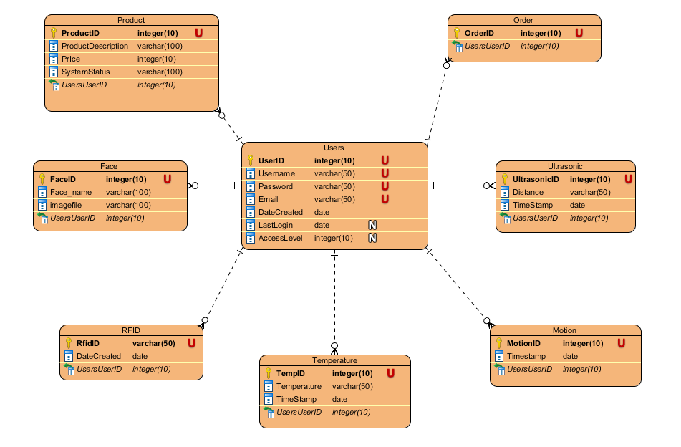
2. Smart Home System Database

Slide 5
3.(a) Smart Sensors
Sensors | Use
Temperature Sensor | Record and monitor temperature of the home 24/7 Based on user’s energy efficiency priority input, suggest optimal temperature setting
Ultrasonic Sensor | Attached to shower head to reduce water wastage. Able to log and calculate electricity output to help reduce monthly bills
Motion Sensor (Camera trigger) | Primary home security system, setup on the ceiling around the house. Turned on when user leaves the home Able to detect slight movements in the room and will trigger a camera system. Which can be remotely managed via app by the user.

Slide 6
3.(b) Smart Sensors
Devices | Use
RFID | Allows users to tap in and login to system upon arriving home. Every user in the home can be assigned to 1 RFID card Each card can save a different home appliance startup configuration
Smart-Door (Facial Recognition cam) | Camera at the door that will turn start upon pressing the doorbell Home user will be notified via app that sends an image of the whoever is at the door with their name if their faces have been saved into the users database User will then be able to unlock the door and grant entry for the guest

Slide 7
4. System Highlights
Additional Software | Description
Aforge motion trigger camera | Open source aforge library, activates when motion is detected. Detect home intrusion, sends message to user when motion is detected with live video feed.
OpenCV facial recognition camera | Open source facial recognition library with cross platform .NET wrapper “EMGU.CV”. Used as a smart door system, that can be trained to recognise faces that the user want. Sends alert to user when doorbell is pressed. Camera will activate for 10 seconds and try to recognise the face. If no face is detected user will not receive alert. If unfamiliar face or face is detected, user will receive a message with an image snapshot of the person at the door.

Slide 8
5. Project Task Allocation
Website Team | Thomas Lee (Leader) Web Form: (All masterpages), login/logout/register, cart, home(guest/user), smarthome(guest/user), Sensordisplay Additional: CSS, Ajax panels, Sessions Windows Form: Facial Detection, Doorbell Security Form Database: Users, Face, Product, Order Documentation: Project Proposal, User Manual (Web form), Presentation Slides, Integration | Clynton Loh Web Form: About, Forgot password, Product Database: Product Documentation: Project Proposal
Windows and Netduino Team | Shaun Lim Web Form: Energypage.aspx Windows Form: Motion, Temperature, Ultrasonic, Admin, Login, Sensor Forms. Buzzer, RFID, Dooview Netduino: UART Additional: A-forge camera Database: Motion, RFID, Temperature, Ultrasonic, Users Documentation: Project Proposal, User Manual (Windows form), Presentation Slides | Wafiy Windows Form: Debug Netduino: Debug Additional: DateTime Picker Documentation: Project Proposal, User Manual (Windows form)

